Slide 1

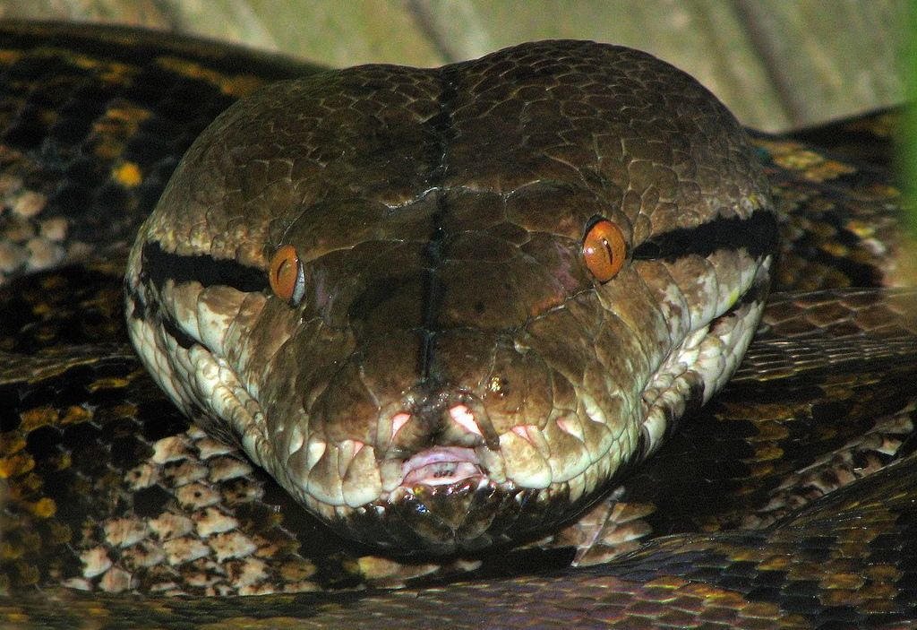
CHAPTER - 09
DATA HANDLING

Slide 2

Unit 2:
XI
Computer Science (083)
Board : CBSE
Programming and Computational Thinking
Courtesy CBSE

Slide 3
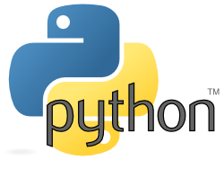
CHAPTER - 03
DATA HANDLING

Slide 4
INTRODUCTION

Slide 5
INTRODUCTION
Data can be of many types e.g. character, string, integer, real etc.
Python like any other language provides ways and facilities to handle different types of data by providing data types.

Slide 6
PYTHON DATA TYPES

Slide 7
PYTHON DATA TYPES
What is Data type?
DATA TYPES are means to identify the type of data and associated operations of handling it.

Slide 8
PYTHON DATA TYPES
Data Types
Integers
Floating Point Numbers
Complex Numbers
Strings
Tuples
Dictionary
None
List

Slide 9
NUMBERS

Slide 10
NUMBERS
The numbers can be represented in the python as:
(i) Integers.
(ii) Floating point Numbers.
(iii) Complex Numbers.

Slide 11
(i) INTEGERS

Slide 12
(i) INTEGERS
Integers numbers are whole numbers (without any fractional part).
For example: 123,-789 etc.

Slide 13
TYPES OF INTEGERS
There are two types of integers:
Integers (Signed).
Booleans.
Signed Integers
Booleans
  Types
  of
  Integers

Slide 14
TYPES OF INTEGERS

Slide 15
(i) INTEGERS (SIGNED)
Integers can be of any length. Its only limited by the memory available.
It’s a signed representation, i.e., the integers can be positive or negative.

Slide 16
(ii) BOOLEANS

Slide 17
(ii) BOOLEANS
Boolean data types are the truth values, i.e., True form or False form.
Boolean data type is a one kind of integer type they can be represented in the integer form i.e., 0 and 1.

Slide 18
(ii) BOOLEANS
practically one can execute as
>>>bool(0)
will give result as false
>>>bool(true)
will produce 1 result.

Slide 19
str ( ) Function

Slide 20
str ( ) Function
str ( ) function coverts a value to string type.
>>>str(false)
will give string type result ‘false’
>>>str(true)
will produce string type ‘true’ result.

Slide 21
(ii) FLOATING POINT NUMBERS

Slide 22
(ii) FLOATING POINT NUMBERS
A numbers containing fractional part is called floating point number.
for example: 93.452
Floating point numbers can be written in two forms.
Note: Floating point numbers have precision of 15 Digits( double precision) in python.

Slide 23
(ii) FLOATING POINT NUMBERS
Fractional Form
Exponent Notation
Floating Point Numbers
Note: Floating point numbers have precision of 15 Digits( double precision) in python.

Slide 24
Advantages of Floating Point Numbers

Slide 25
(ii) Advantages of Floating Point Numbers
They can represent range of values between the integers.
They can represent a greater extent/ range of values.
Note: Floating point numbers have precision of 15 Digits( double precision) in python.

Slide 26
Disadvantages of Floating Point Numbers

Slide 27
(ii) Disadvantages of Floating Point Numbers
Floating-point operations are usually slower than integer operations.
Note: Floating point numbers have precision of 15 Digits( double precision) in python.

Slide 28
(iii) COMPLEX NUMBERS

Slide 29
(iii) COMPLEX NUMBERS
A complex number is a number that can be expressed in the form a + bi,
where,
a and b are real numbers, and
i is called an imaginary number.
For the complex number a + bi, a is called the real part, and b is called the imaginary part.

Slide 30
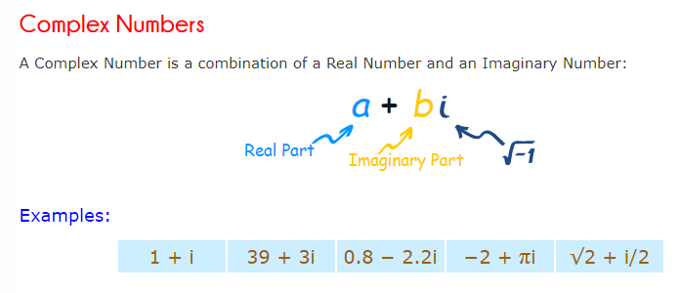
(iii) COMPLEX NUMBERS

Slide 31
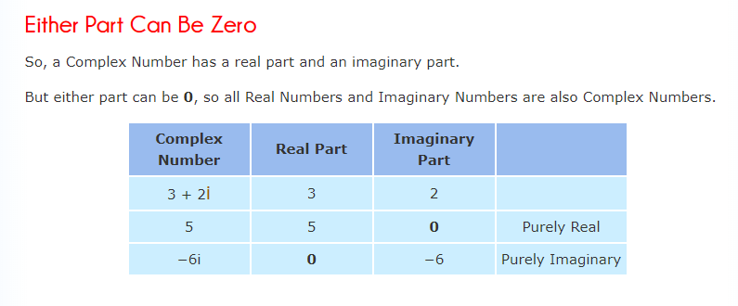
(iii) COMPLEX NUMBERS

Slide 32
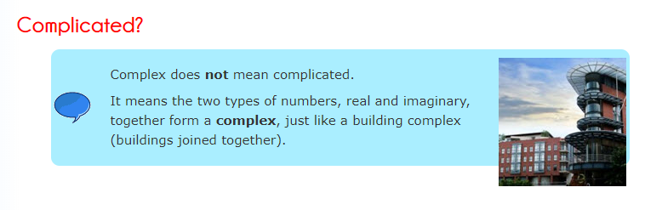
(iii) COMPLEX NUMBERS

Slide 33
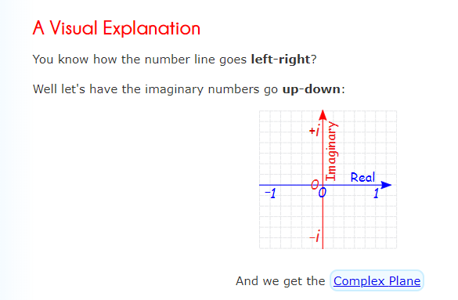
(iii) COMPLEX NUMBERS

Slide 34
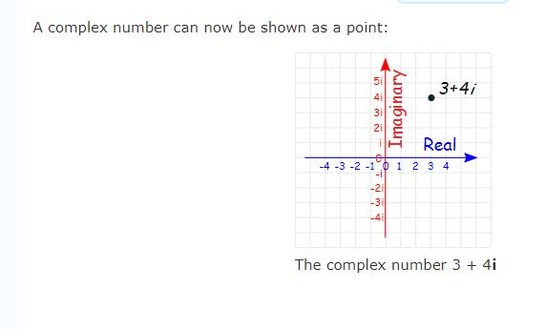
(iii) COMPLEX NUMBERS

Slide 35
COMPLEX NUMBERS IN PYTHON

Slide 36
COMPLEX NUMBERS IN PYTHON
complex number is made up of real and imaginary parts.
Real part is a float number, and imaginary part is any float number multiplied by square root of -1 which is defined as j.

Slide 37
COMPLEX NUMBERS IN PYTHON
>>> no=5+6j
>>> no.real o/p 5.0
>>> no.imag o/p 6.0
>>> type(no)
<class 'complex'>

Slide 38
COMPLEX NUMBERS IN PYTHON
Python library also has complex() function, which forms object from two float arguments
>>> no=complex(5,6)
>>> no (5+6j)
>>> no.real o/p 5.0
>>> no.imag o/p 6.0
>>> type(no)
<class 'complex'>

Slide 39
Data Type Range

Slide 40
Data Type Range
Data Type | Range
Integers | Unlimited subject to availability of memory
Booleans | True ( 1 ), False ( 0 )
Floating Point Numbers | Unlimited subject to availability of memory and depends on machine architecture.
Complex Numbers | Same as float type

Slide 41

UNICODE

Slide 42
What is UNICODE?
Unicode provides a unique number for every character,
no matter what the platform,
no matter what the program,
no matter what the language.

Slide 43
UNICODE HISTORY

Slide 44
UNICODE HISTORY
The origins of Unicode date to 1987, when Joe Becker from Xerox with Lee Collins and Mark Davis from Apple, started investigating the practicalities of creating a universal character set.

Slide 45
UNICODE HISTORY
With additional input from Peter Fenwick and Dave Opstad, Joe Becker published a draft proposal for an "international/multilingual text character encoding system in August 1988, tentatively called Unicode". He explained that the name 'Unicode' is intended to suggest a unique, unified, universal encoding".

Slide 46
UNICODE ADOPTION

Slide 47
UNICODE ADOPTION
It has been adopted by all modern software providers and now allows data to be transported through many different platforms, devices and applications without corruption.
operating systems, search engines, browsers, laptops, and smart phones—plus the Internet and World Wide Web (URLs, HTML, XML, CSS, JSON, etc.) using unicode

Slide 48
UNICODE IMPLIMENTATION

Slide 49
UNICODE IMPLIMENTATION
Unicode can be implemented by different character encodings. The Unicode standard defines UTF-8, UTF-16, and UTF-32, and several other encodings are in use. The most commonly used encodings are UTF-8, UTF-16 and UCS-2, a precursor of UTF-16.

Slide 50
STRINGS

Slide 51
STRINGS
Like many other popular programming languages, strings in Python are arrays of bytes representing Unicode characters. However, Python does not have a character data type, a single character is simply a string with a length of 1. Square brackets can be used to access elements of the string.

Slide 52
How to create a string in Python?

Slide 53
STRINGS
How to create a string in Python?
Strings can be created by enclosing characters inside a single quote or double quotes. Even triple quotes can be used in Python but generally used to represent multiline strings and docstrings.

Slide 54
REPRESENTATION OF STRING

Slide 55
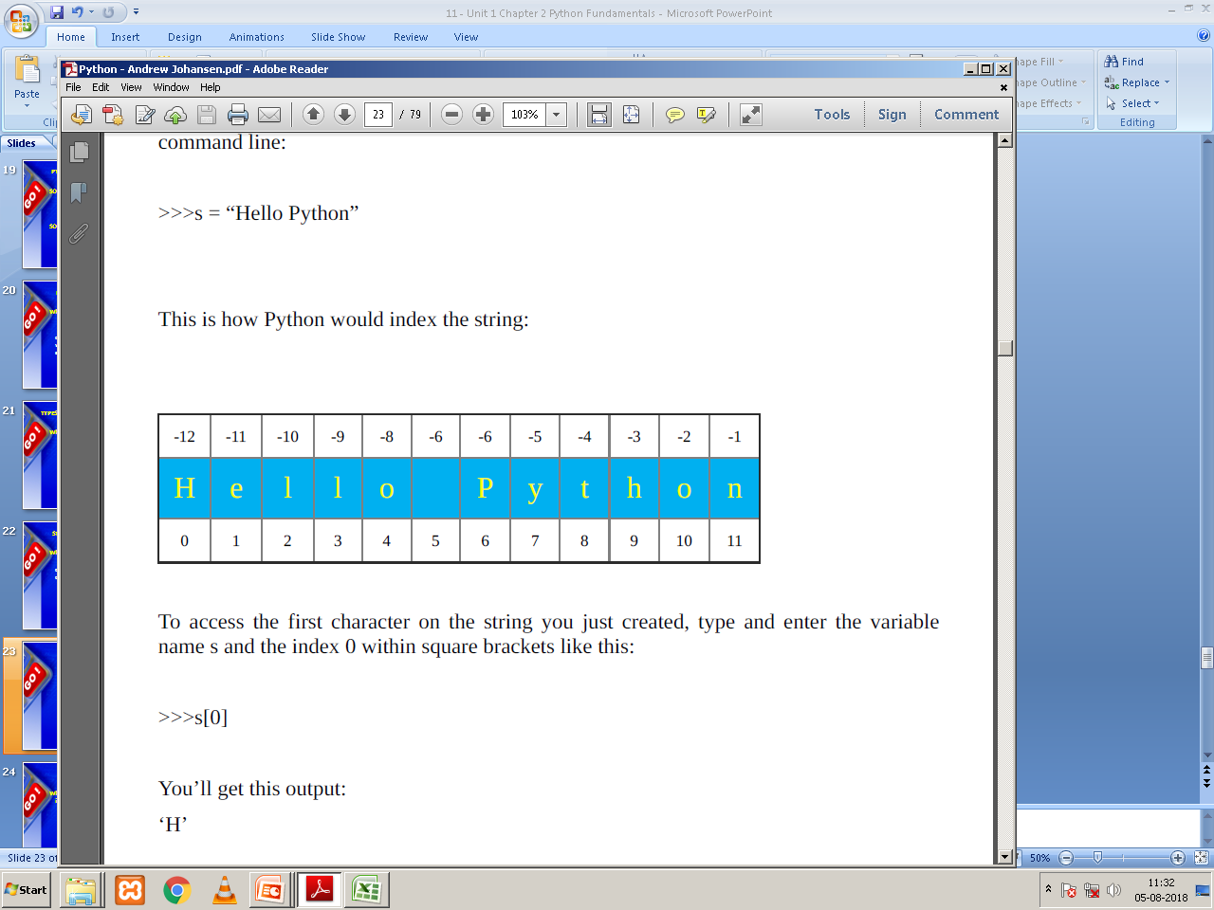
REPRESENTATION OF STRING
>>> s = “Hello Python”
This is how Python would index the string:
Backward Indexing
Forward Indexing

Slide 56
STRINGS – Programming Example

Slide 57
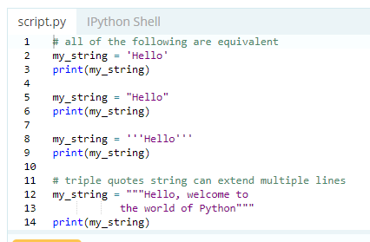
STRINGS - Example
Output Next Slide...

Slide 58
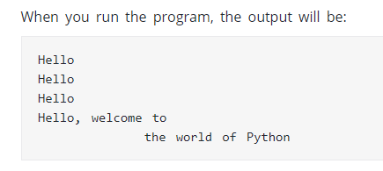
STRINGS - Example

Slide 59
How to access characters in a string?

Slide 60
STRINGS
How to access characters in a string?
We can access individual characters using indexing and a range of characters using slicing. Index starts from 0. Trying to access a character out of index range will raise an IndexError. The index must be an integer. We can't use float or other types, this will result into TypeError.

Slide 61
STRINGS
How to access characters in a string?
Python allows negative indexing for its sequences.
The index of -1 refers to the last item, -2 to the second last item and so on. We can access a range of items in a string by using the slicing operator (colon).

Slide 62
STRINGS – Programming Example

Slide 63
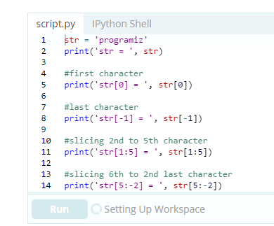
STRINGS

Slide 64
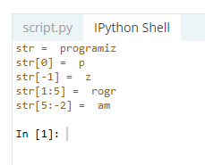
STRINGS

Slide 65
SLICING STRINGS EXAMPLES
For example:
>>>“Program”[3:5]
will result in:
‘gr ’
>>>“Program”[3:6]
will yield:
‘gra’
>>>p = “Program”
>>>p [4:]
‘ram’
>>>p = “Program”
>>>p [3:6]
‘gra’

Slide 66
SLICING STRINGS EXAMPLES
For example:
>>>p = “Program”
>>>p [:4]
‘Prog’

Slide 67
Index Error!

Slide 68
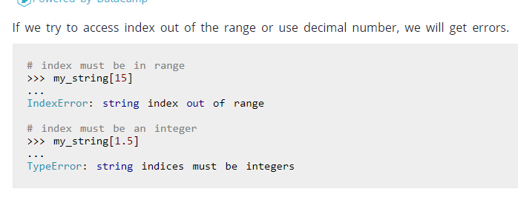
STRINGS –Index error

Slide 69
MUTABLE AND IMMUTABLE OBJECTS IN PYTHON

Slide 70
MUTABLE AND IMMUTABLE OBJECTS
What is Mutable Object?
In object-oriented programming language , an immutable object is an object whose state/ values can be modified after its creation.
In short the an object / variable, for which we can change the value is called mutable object or mutable variable.
For example : Lists are mutable in nature.

Slide 71
MUTABLE AND IMMUTABLE OBJECTS
What is Immutable Object?
In object-oriented programming language, an immutable object is an object whose state/ values can not be modified after it’s creation.
In short an object or a variable , for which we can not change the value is immutable object or immutable variable.
For example : Tupels are immutable in nature.

Slide 72
TUPLES

Slide 73
TUPLES
What is Tuples?
Lists and tuples can be thought of as generic "buckets" with which to hold an arbitrary number of arbitrary Python objects.

Slide 74
TUPLES
What is Tuples or Tuple?
Tuples are the type of data it is a sequence of immutable Python objects. Tuples are sequences, just like lists. The differences between tuples and lists are, the tuples cannot be changed unlike lists and tuples use parentheses, whereas lists use square brackets. Creating a tuple is as simple as putting different comma-separated values

Slide 75
EXAMPLES ON TUPLES

Slide 76
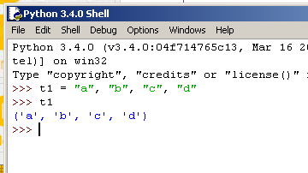
TUPLES EXAMPLE
DEFINING TUPLES WITHOUT ( )

Slide 77
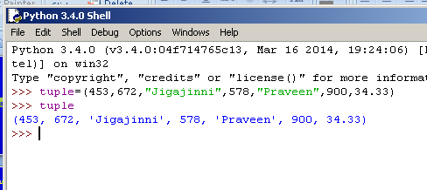
TUPLES EXAMPLE
DEFINING TUPLES WITH ( )

Slide 78
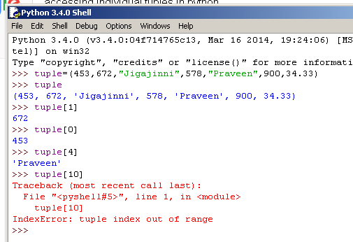
TUPLES EXAMPLE – Accessing individual
elements using index number in [ ]

Slide 79
LISTS

Slide 80
LISTS
A list is a data type that can be used to store any type and number of variables and information.
Lists are mutable in nature.
General format of list is :
my_list = [item_1, item_2, item_3]
Python also allows creation of an empty list:
my_list = []
For Example
colors = ["Orange" , "red" , "Green" , "White“]

Slide 81
LISTS EXAMPLE

Slide 82
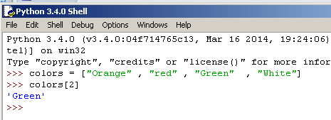
LISTS
Note: Lists are mutable in nature.

Slide 83
PRECEDENCE OF AN OPERATORS

Slide 84
PRECEDENCE OF AN OPERATOR
Operator | Description
** | Exponentiation (raise to the power)
~ + - | Complement, unary plus and minus (method names for the last two are +@ and -@)
* / % // | Multiply, divide, modulo and floor division

Slide 85
PRECEDENCE OF AN OPERATOR
Operator | Description
+ - | Addition and subtraction
>> << | Right and left bitwise shift
& | Bitwise 'AND'td>
^ | | Bitwise exclusive `OR' and regular `OR'
<= < > >= | Comparison operators
<> == != | Equality operators

Slide 86
PRECEDENCE OF AN OPERATOR
Operator | Description
= %= /= //= -= += *= **= | Assignment operators
is is not | Identity operators
in not in | Membership operators
not or and | Logical operators

Slide 87
EXAMPLE ON
PRECEDENCE OF AN OPERATOR

Slide 88
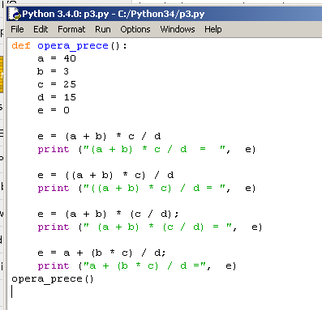
PRECEDENCE OF OPERATOR EXAMPLE

Slide 89
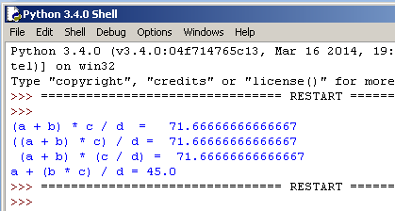
PRECEDENCE OF OPERATOR EXAMPLE

Slide 90



Any Questions Please

Slide 91
CLASS TEST
ON
DATA TYPES
CHAPTER

Slide 92
CLASS TEST ON DATA TYPES
Each carries 2 Marks Questions (10 x 2 = 20)
1. What is DATA TYPE?
2. What is tuple/ are tuples? Give syntax or general format and one suitable example.
3. What is mutable object?
4. What is list/ are lists? Give syntax/general format and support with one example
5. What is str ( ) function?
What are the advantages of floating point numbers?
Write down the syntax of complex numbers and give one example.

Slide 93
CLASS TEST ON DATA TYPES
Each carries 2 Marks Questions (10 x 2 = 20)
7. What is an index error?
8. Explain the string representation with proper diagram.
9. What is forward indexing and backward indexing.
10. How to access a specific character from a given string.
***

Slide 94
QUESTION BANK
ON
CHAPTER III
DATA HANDLING

Slide 95
CHAPTER 2: PYTHON FUNDAMENTALS
One Mark Questions
1. What is DATA TYPE?
2. List the Data types?
3. How many ways numbers can be represented in python language?
4. Name the types of Integers?
5. What is str ( ) function?
What are the advantages of floating point numbers?
Write down the syntax of complex numbers and give one example.

Slide 96
CHAPTER 2: PYTHON FUNDAMENTALS
One Mark Questions
8. What is index error?
9. Explain the representation of string with proper diagram.
What is forward indexing and backward indexing?
How to access a specific character from a given string.
What is tuple?

Slide 97
CHAPTER 2: PYTHON FUNDAMENTALS
Two Marks Questions
Write down the syntax of tuple without braces and give one example.
Write down the syntax of tuple with braces and give one example.
What is index? Give example
What is index number? Give example
How an element of tuple/tuples are accessed? Explain with proper example.
Differentiate between mutable and immutable objects.

Slide 98
CHAPTER 2: PYTHON FUNDAMENTALS
Two Marks Questions
7. Differentiate between lists and tuples? Give suitable example.

Slide 99
CHAPTER 2: PYTHON FUNDAMENTALS
Three Marks Questions
1. What are the python naming conventions?
2. Explain the representation of string in python language.
3. Explain the types of strings supported by python language.
4. Explain escape sequences.
5. Explain numerical literals supported in python language.
6. Explain the Floating point literals supported in python language.

Slide 100
Thank You

